Slide 1
Material Literatures NRE Based on BiLSTM-CNN-CRF
Here is the new era for material research

Slide 2
Content
Problem Statement
Dataset and Preprocessing
Model
Model Performance and Analysis
Future and Projection
What we are going to talk today

Slide 3
Problem Statement

Slide 4
Fast Fact
32,000
100
67,900
Materials was discovered based on Springer Materials
Properties that one material may have based on Knovel
Literatures since 2022 related material science based on Google Scholar

Slide 5
Problem Statement
Unstructured text in millions of published scientific articles
Data is big and grow rapidly
Cannot handle large-scale problems

Slide 6
Our Solution
advances in machine learning and natural language processing

Slide 7
Our Solution
Named Entity Recognition

Slide 8
Our Solution
chemistry-based NER systems extracting inorganic materials

Slide 9
Our Solution
supervised machine learning problem

Slide 10
Our Solution
use deep learning models to perform NER tasks on literature in materials science

Slide 11
Dataset And Preprocessing

Slide 12
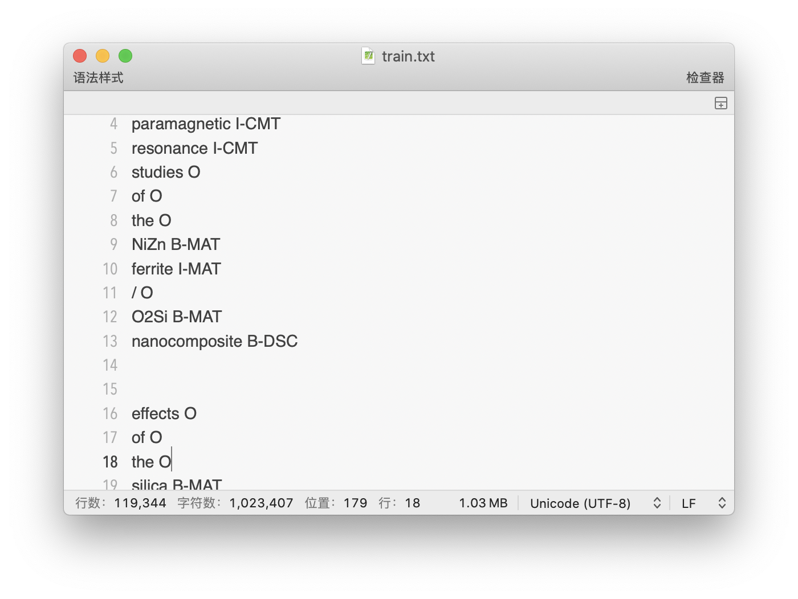
Data Description
Named Entity Recognition and Normalization Applied to Large- Scale Information Extraction from the Materials Science Literature
Generated by Tokenization
Composed by Word and Tag
Divided into train_set , test_set and dev_set
110537 Records in train
13992 Records in test

Slide 13
Data Preprocessing
__________________
char2vec converts a sentence into a vector with character index
Converts char, word, tag vectors
__________________
word2vec transforms the sentence into a vector with word index
__________________
tag the label corresponding to each word to transform the sentence into a sequence vector
__________________

Slide 14
Data Preprocessing
Sequence_vec
O | B-CMT | O | I-CMT | I-MAT
of | electron | the | resonance | ferrite
o | e | t | r | f
f | l | h | e | e
 | e | e | s | r
 | c |  | o | r
 | t |  | n | i
 | r |  | a | t
 | o |  | n | e
 | n |  | c
 |  |  | e
Word_vec
Converts char, word, tag vectors
Character_vec

Slide 15
Get Standard Input
Data Preprocessing
To keep the vector dimensions consistent, in the process of character2vec, we set the dimensions of all character_vec to the length of the longest word. Fill the under length with padding
Similarly, the same method is used to keep the dimensionality of the word vectors consistent
The above operations are performed on the train, test, and dev datasets separately

Slide 16
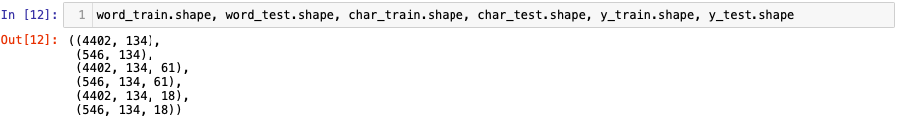
Final Data
Data Preprocessing

Slide 17
Model and Implementation

Slide 18
Model History
CNN for character encoding
In 2014, Santos et al. have shown that CNN is an effective approach to extract morphological information
Bidirectional LSTM network
RNN
Long Short-Term Memory
BiLSTM proposed by Graves et al. in 2013

Slide 19
Model History
CRF in sequence labeling
It is beneficial to consider the correlations between labels in neighborhoods and jointly decode the best chain of labels for a given input sentence.
CNN-BiLSTM-CRF
Huang et al. in 2015 performed the task of sequence labeling with BiLSTM and CRF achieve a 88.83% accuracy in CoNLL2003.
Ma et al. in 2016, added CNN to the model, which achieved 97.55% accuracy on the test set of POS task.

Slide 20
Model Principle
Character Representation based on 1D-CNN

Slide 21
Model Principle
Word Embedding
Concatenation
BiLSTM
CRF

Slide 22
Model Principle
Model Structure

Slide 23
Model Implementation
Layers.TimeDistribution() Function
Dropout
Code

Slide 24
Model Performance and Analysis

Slide 25
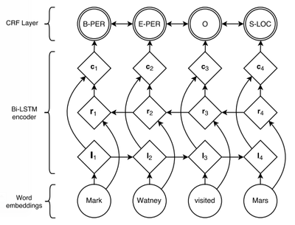
Model Advantages
CNN
past and future features
CRF transition matrix

Slide 26
Model Performance
CNN-BiLSTM-CRF
Bert-base
Predicting on our data
96%
93%

Slide 27
Bert Advantage
What is the advantage of Bert?
Embedding
Concurrent Computing

Slide 28
Bert Advantage
Different between our model and Bert while embedding:
Token
Character Embedding after CNN
Position
Word
Segment

Slide 29
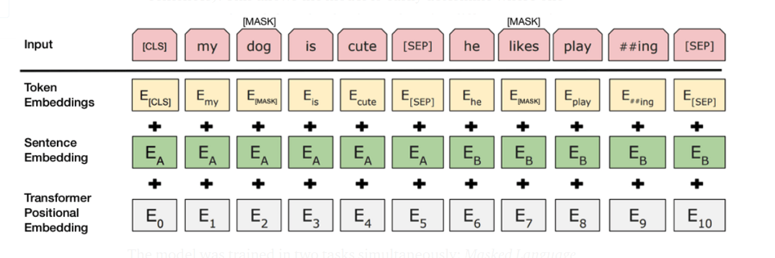
Bert Advantage

Slide 30
Bert Advantage
Different between our model and Bert while embedding:
Token
Character Embedding after CNN
Position
Word
Segment

Slide 31
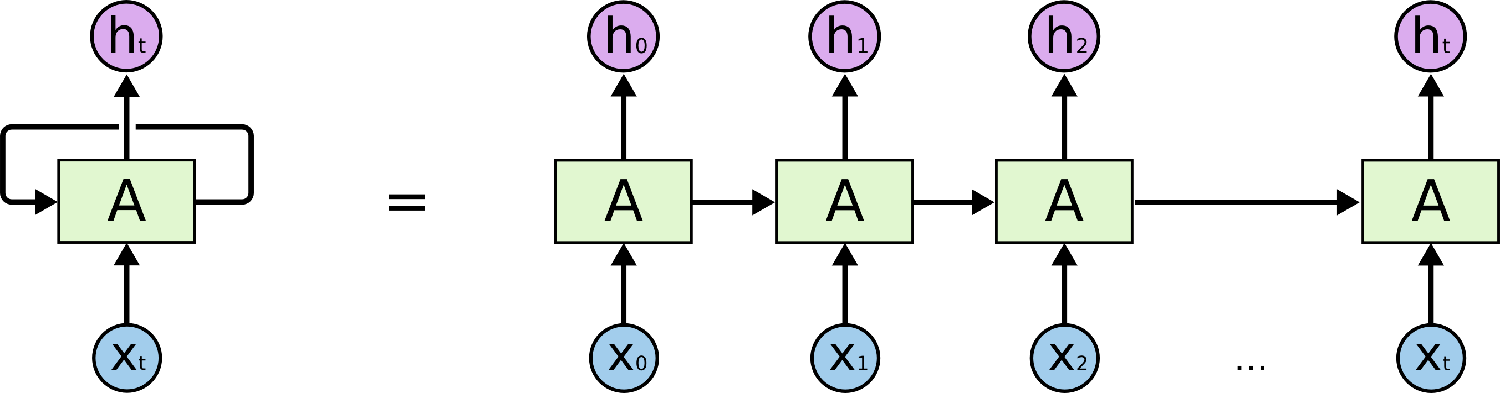
Bert Advantage
LSTM has no Concurrent Computing Between Cells

Slide 32
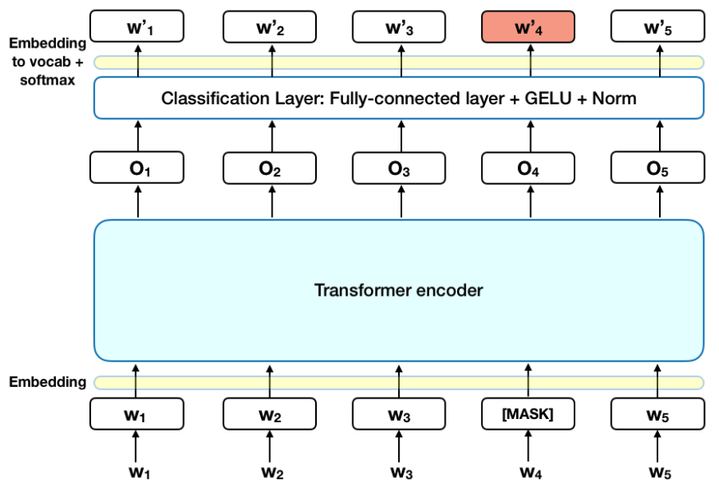
Bert Advantage
Bert Concurrent Computing

Slide 33
Why Less Better
Difference between bidirectional mechanisms
Why Our Bert-Base Perform Less Better?
Data set mismatch

Slide 34
Future and Projection

Slide 35
Current Limitation
Embedding Tools
Difficulty in Tagging
Small sample
size
There is a lack of Embedding Tools specifically for materials science
Unlike Twitter or Weibo, the tagging of material science literature can only be done by professionals, which is time-consuming and expensive.
We should do more literature acquisition and then build a larger training database

Slide 36
Future Plan
Customized Feature
Bert
Database construction
construct some custom features for CRF as the third input
Using Bert instead of CNN for text feature extraction in the future
build a structured materials science database

Slide 37
Thanks!
Do you have any questions?
Please keep this slide for attribution

